Slide 1

Lesson: 1.01 Setup
Microsoft Philanthropies TEALS Program
Introduction to computer science

Slide 2
Setup
After this lesson, you will be able to...
Define and identify Python and Jupyter Notebooks
Identify the key concepts that will be covered in the course
Create, save and share a Jupyter Notebook in Google Colab

Slide 3
Today’s plan
Do now
Syllabus
Python and text editor introduction

Slide 4
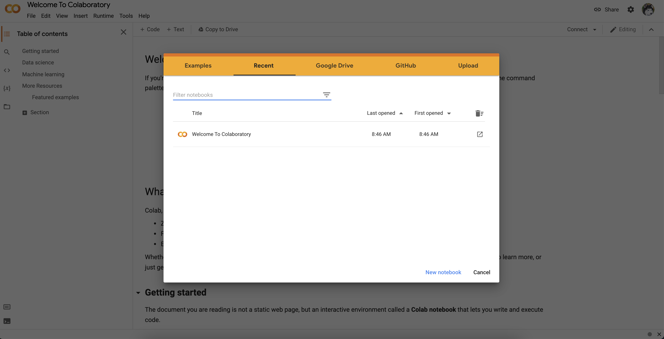
Do now
Go to https://colab.research.google.com/ and choose “New Notebook” at the bottom.
Notes:
Give students 3-4 minutes to follow the instructions on the Do Now page.
Debrief the answers to the questions on the Do Now by calling on students to respond.

Slide 5
Syllabus
Goals for this course
  Create functioning Python programs
  Learn to use basic data types
  Earn to use a text-based language
Present demo of a program written in Python to hook students and to give them an idea of what they will be working with
Notes:
Remind students of creating a block in Snap!

Slide 6
Overview of this course
The major topics covered in this course are as follows:
  Variables
  Conditionals
  Loops
  Functions (user-defined and built-in)
  Lists
  Classes and objects
  Dictionaries
  Music programming
Notes:
Feel free to edit this slide based on the guidance from the curriculum map and the goals for this course.

Slide 7
Lab Projects
Unit 1: MadLibs
Unit 2: Text adventure game
Unit 3: Oregon trail game
Unit 4: Tic-Tac-Toe (2 human players)
Unit 5: Music programming in EarSketch
Unit 6: Guess who? Game
Unit 7: Pokémon
Unit 8: Final project - student created
Notes:
Feel free to edit this slide based on the guidance from the curriculum map and the goals for this course.

Slide 8

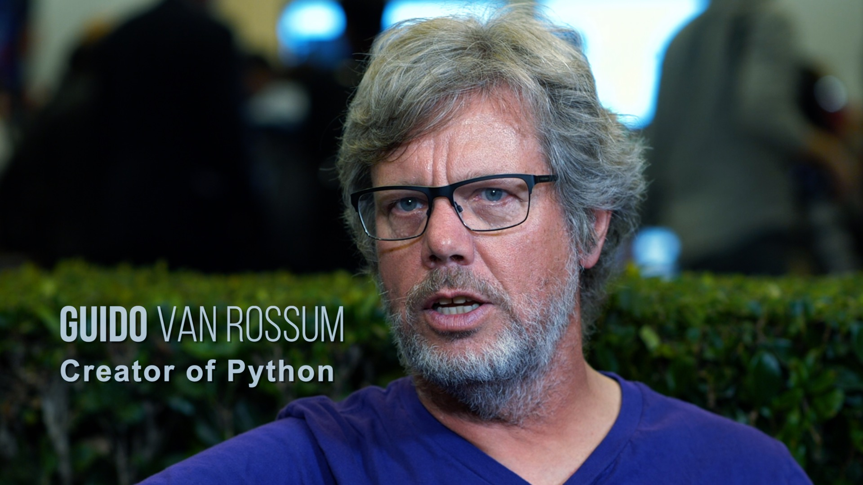
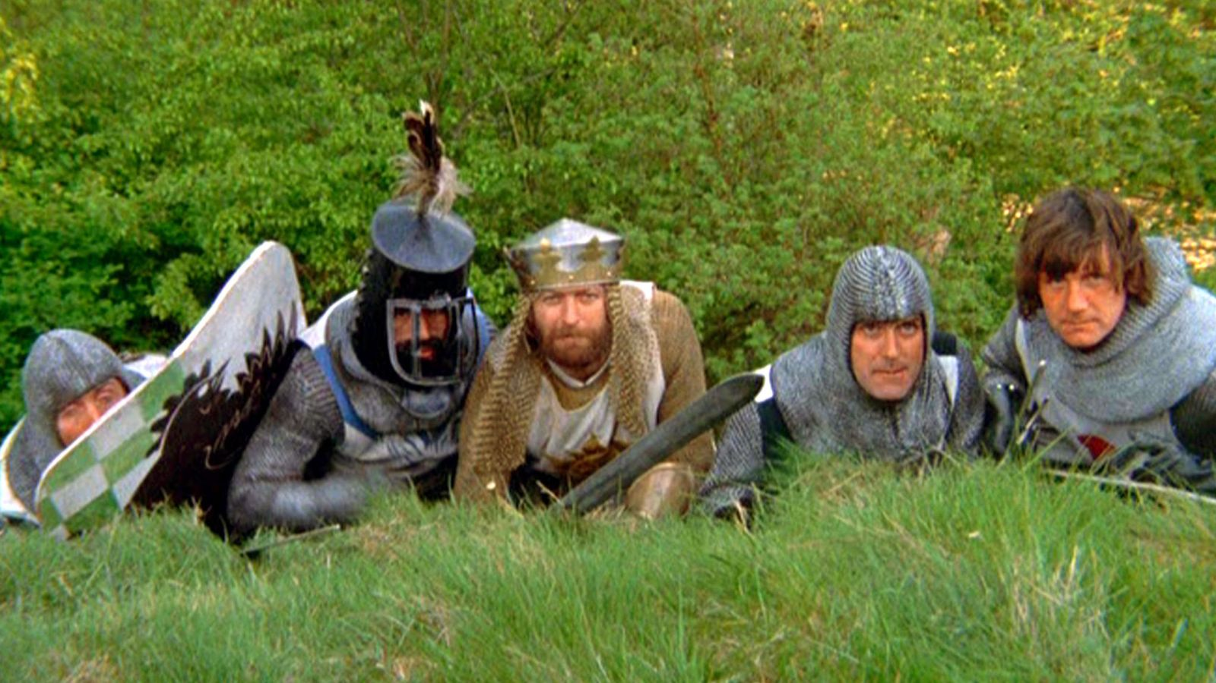
What is Python?
Python is a text-based programming language.
First released 1991. Python3 released 2008.
Widely used in industry and academia.
  100,000,000+ lines of Python at Google, Inc.
Invented by Guido van Rossum in the Netherlands.
Known for its readability.
Named after BBC TV show Monty Python's Flying Circus.

Slide 9
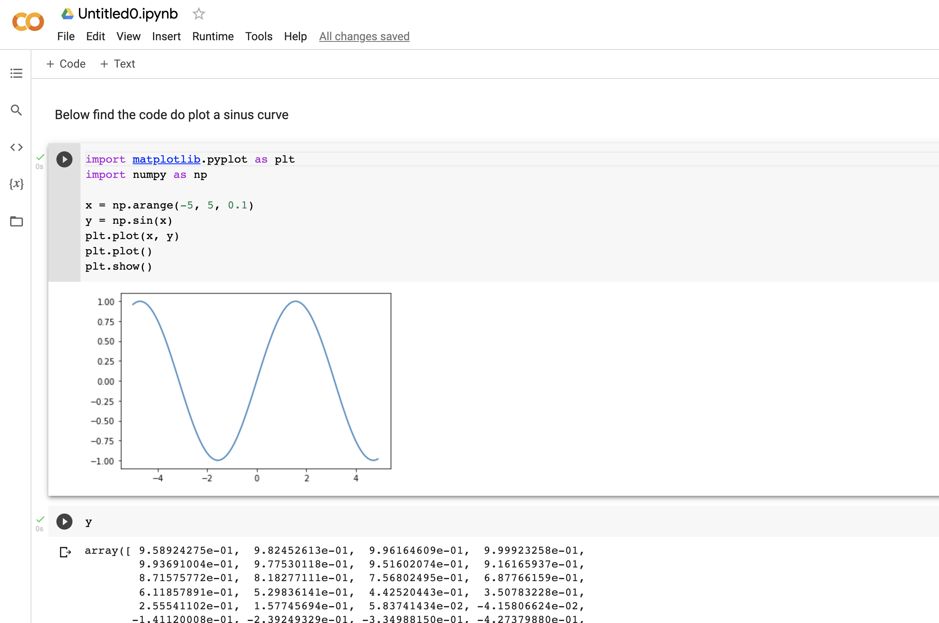
Jupyter Notebooks
The Jupyter Notebook is a web-based programming environment.
It combines live code, equations, narrative text, visualizations, etc.

Slide 10
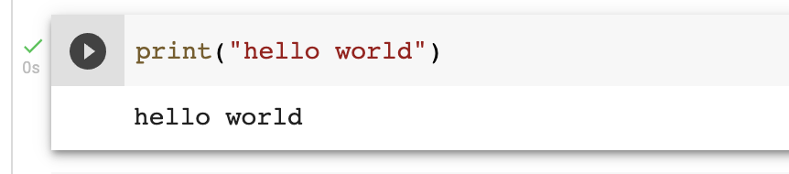
Hello world
Write the following code cell to print “Hello World”
Quotation marks matter
Parentheses matter
Text coloring happens automatically
Use shift-enter or hit the play button to execute

Slide 11
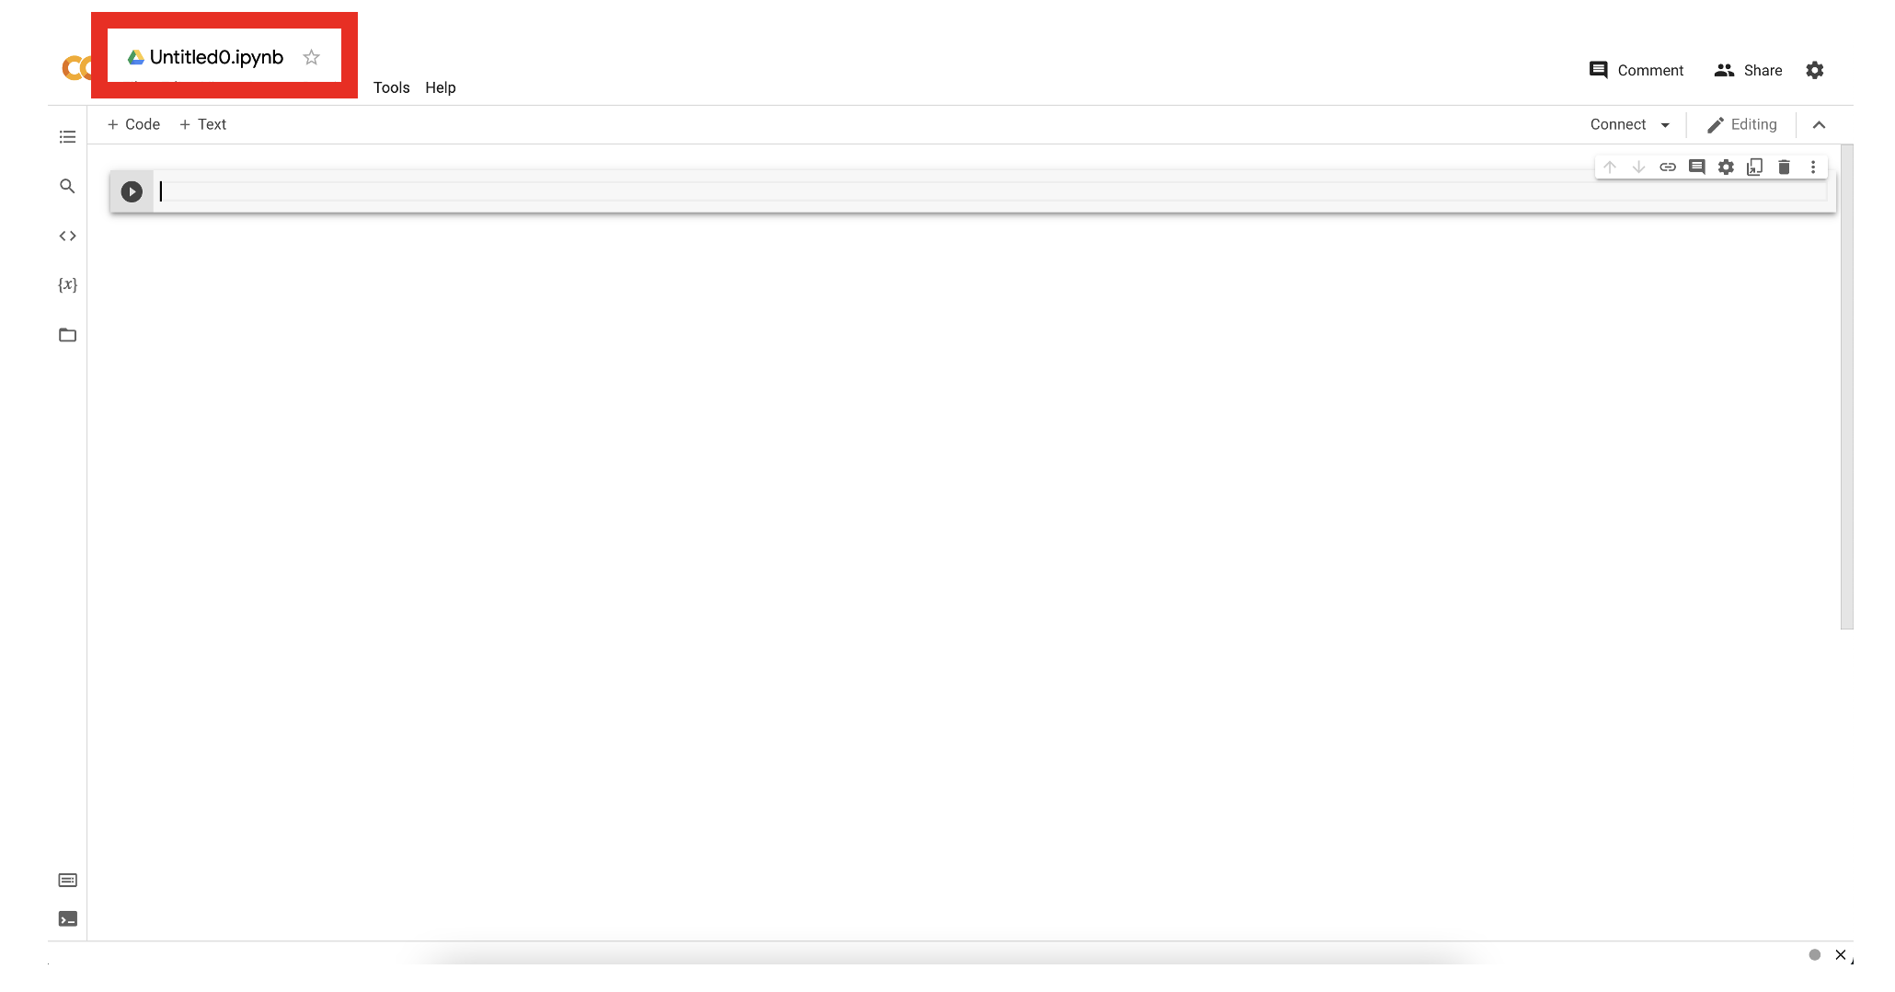
Rename the Jupyter Notebook

Slide 12
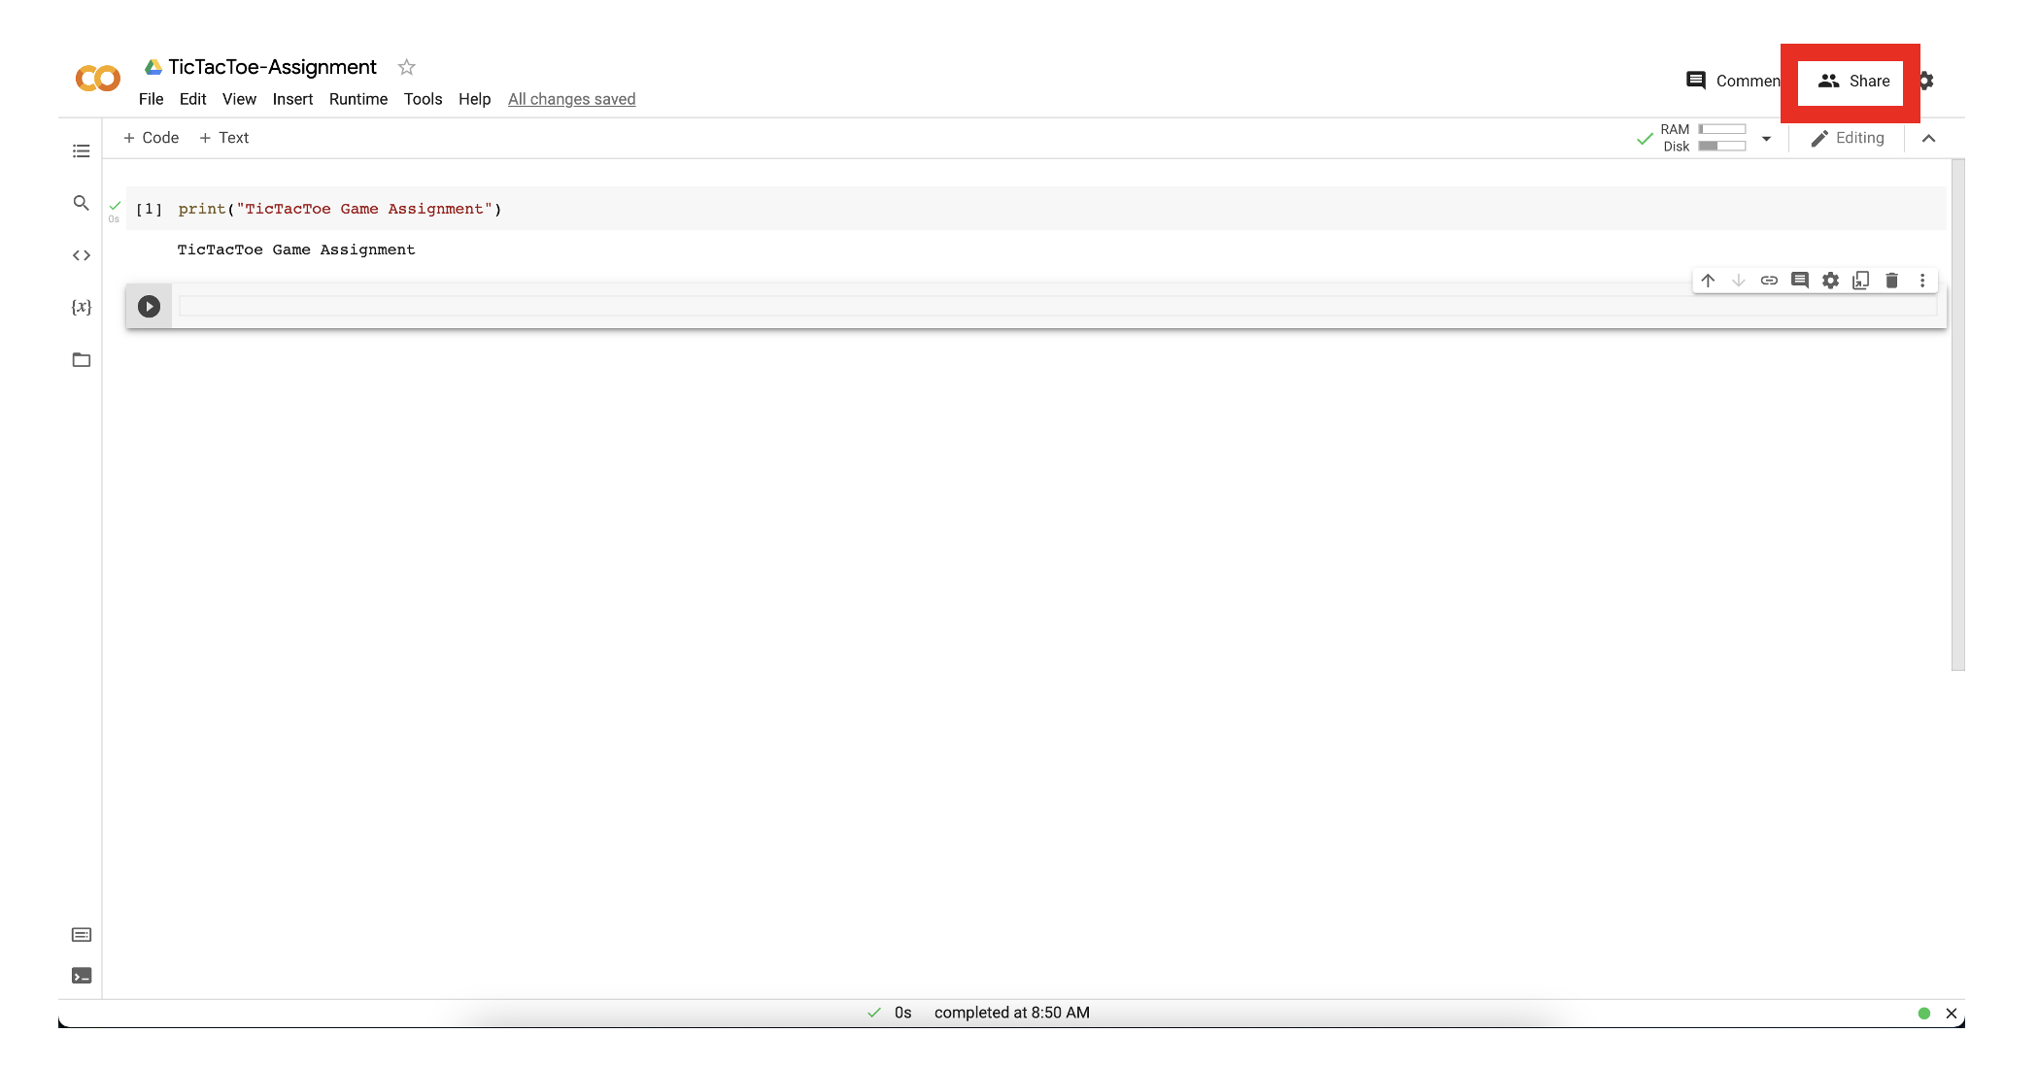
Click Share

Slide 13
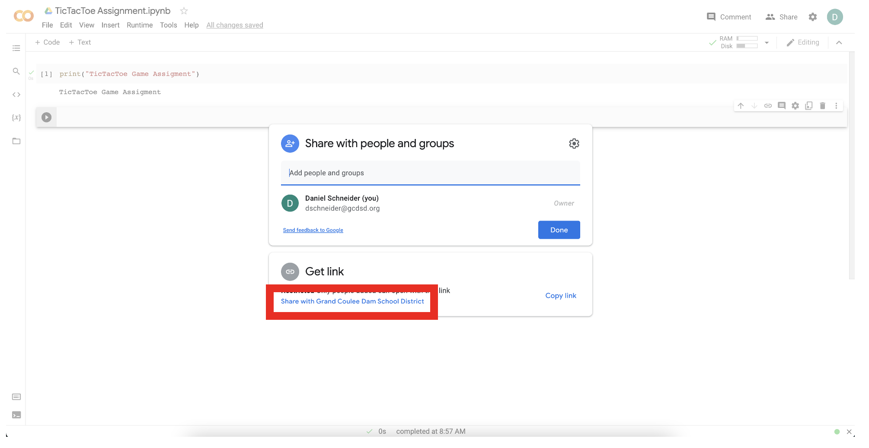
Click Share with Grand Coulee Dam School District

Slide 14
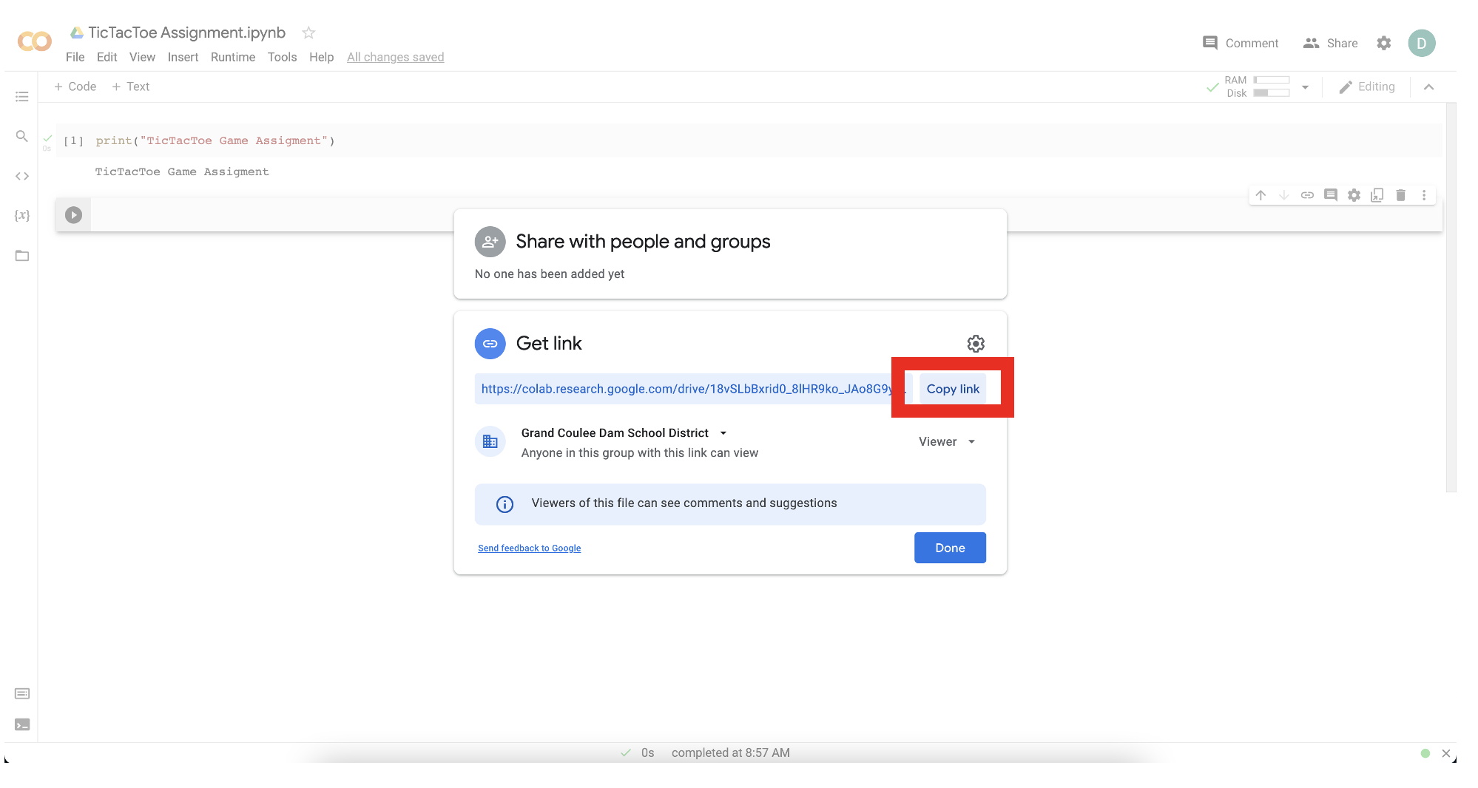
Copy link to share in Google Classroom

Slide 15
Lesson: 1.02 Interactive Mode
Microsoft Philanthropies TEALS Program – Introduction to Computer Science – Semester 2

Slide 16
Interactive Mode
After this lesson, you will be able to...
Define and identify interpreter, string, integer, float, value, errors, console, expression
Use the Python interpreter to evaluate simple math expressions
Distinguish between an integer, float, and string

Slide 17
Today’s Plan
Do Now
Lesson
Lab Part 1 Discussion
Lab Part 2 Discussion
Debrief
Notes:
5 Minutes - Do Now
10 Minutes - Lesson
15 Minutes – Lab Part 2 Discussion
20 Minutes – Lab Part 2 Discussion
5 Minutes - Debrief

Slide 18
Do Now
Read the Following 1.1 Associated readings
https://tealsk12.github.io/2nd-semester-introduction-to-computer-science/readings.md.html
In your Notebook,
Write down three major learning from the reading.

Slide 19
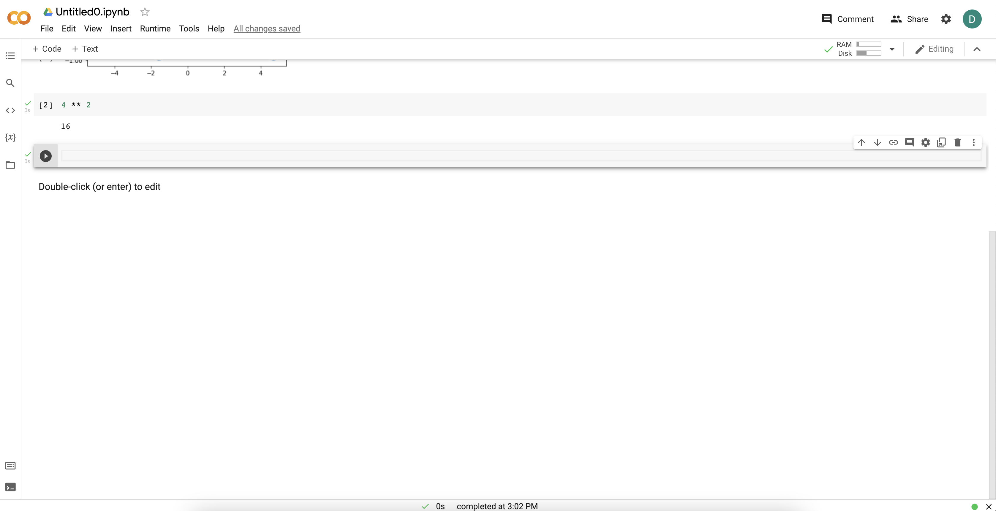
Using Colab Notebooks
Type Here and hit Play or <shift>-<enter>

Slide 20
Key Terms – Write in your Notebook
Value - A single piece of data in Python (e.g. 2, “Hello, World”).
Type - A classification for data which tells the interpreter how it will be used.
  Integer - A type containing a whole number …, -2, -1, 0, 1, 2, …
  String - A type containing a series of characters. Usually written using quotes (e.g. “Hello, World”).
  Float - A type containing a decimal value.
Operators - Symbols that represent computations (e.g. +, -, /, *).
Expressions - A combination of values, variables, and operators. (e.g. 2+3).
Statement - A unit of code that Python can execute.
Variable - A name that refers to a value.

Slide 21
Lab 1.03 – Section 1 Discussion
What does the // do?
How is that different from /?
And how are those different from %?
What’s the difference between 3.0 and 3?
Key Terms
  Floats: a data type, number with a decimal point.
  Integers: a data type, number without a decimal point.
Now work through Section 2

Slide 22
Lab 1.03 – Section 2 Discussion
What happened when you typed in a?
What do you think that error message mean?
Key Term
  String: a data type, characters surrounded in single or double quotes.
Now, work through section 3

Slide 23
Lab 1.03 – Section 3 Discussion
What was the difference between the two inputs?
Strings can be combined using +.
What do you think the error message means?
You can’t combine different types!
Now, work through section 4

Slide 24
Lab 1.03 – Section 4 Discussion
What error did you get?
What do you think that means?
What happens when you multiply strings?

Slide 25
Lab Part 2
Define expression: a combination of values and operators (and variables)
In your notebook,
  Give an example of an expression
  Write down their predictions before going to the interpreter/IDE to check the actual output.

Slide 26
Lesson 1.03: Script Mode and Variables
Microsoft Philanthropies TEALS Program
Introduction to Computer Science
Semester 2

Slide 27
Script Mode and Variables
After this lesson, you will be able to...
Define and identify script, print, run, output, variable
Write a simple script and run it in the text editor
Print values out to the console (both composed values and from variables)
Compare script mode vs interactive mode
Know how to store a value into a variable

Slide 28
Plan
Day 1
Do Now
Lesson
Lab
Debrief
Notes:
Day 1
5 Minutes - Do Now
10 Minutes - Lesson
35 Minutes - Lab
5 Minutes - Debrief

Slide 29

Do Now
Open and save a new notebook called DoNow103 in Collab.
Run a cell by clicking the Play button.
Practice typing the following expressions in the editor and running the code.
  2 * 3 * 5
  "abc“
  "abc" + "bde"
Now try typing the statement below into the file.
Save and run the code
1. print(2*3*5)
Notes:
Students should answer the questions in their notebook.
Connect Lessons together.

Slide 30
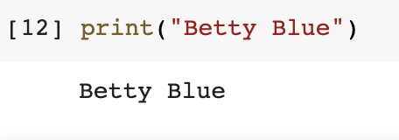
Print Statement
print(“Betty Blue”)

Slide 31
Variables
A name that refers to a value
An assignment statement creates new variables and gives them values:
>>> n = 17
>>> pi = 3.1415926535897932
>>> message = 'And now for something completely different’
Which are assignments and which are the variables?

Slide 32
Variable Names
Variable names - letters, numbers and some punctuation marks are legal
  The first character can’t be a number.
  You can’t use a keyword as the name of a variable, and you should avoid using duplicate names
  Can be of any length
  Use common sense variable names

Slide 33
Illegal Variable Names
If you give a variable an illegal name, you get a syntax error:
>>> 76trombones = 'big parade'
SyntaxError: invalid syntax
>>> more@ = 1000000
SyntaxError: invalid syntax
>>> class = 'Advanced Theoretical Zymurgy'
SyntaxError: invalid syntax
Notes:
76trombones is illegal because it does not begin with a letter.
more@ is illegal because it contains an illegal character, @.
But what’s wrong with class?
It turns out that class is one of Python’s keywords. The interpreter uses keywords to recognize the structure of the program, and they cannot be used as variable names.

Slide 34

Variables Exercise – Lab Assignment Sections 1 and 2
Type and run the following code.
animal = "dogs"
print(animal + " are really cool.")
Type and run the following code.
print(dogs + " are cool.")
Rewrite the following in Python:
Notes:
What does print do? - similar to say in BYOB

Slide 35
Lab Part 3 - The Four Fours challenge
Using four 4's and any operations, try to write equations that have the numbers from 0 to 4 as the answer.
Use Python's arithmetic operations:
  ( ) parentheses for grouping
  ** Exponents
  * multiplication
  / division
  + addition
  - subtraction or negation

Slide 36
Lab Part 3
You may also use 44 or 4.4, which count as two fours, or .4, which counts as one four. For example, one solution for zero is:
  print("Zero is", 44-44)
Can you find a different solution?
Here are what the results, but not the source code, will look like. (Note: 1 may be displayed as 1.0 – This is ok)
  Zero is 0
  One is 1
  Two is 2
  Three is 3
  Four is 4

Slide 37
Bonus
Print the output below, but only using one line of code. (Feel free to use online resources.)
  Wow!
  This is on a new line!
Can you find four fours for 5 to 10?

Slide 38
Lesson: 1.04 Variable input
Microsoft Philanthropies TEALS Program
Introduction to computer science

Slide 39
Variable Input
After this lesson, you will be able to...
Define and identify comments, storing, mutability, variable assignment, input
Assign and swap variables
Store user input into a variable

Slide 40
Plan
Do now
Continue do now & discussion
Magic genie lab
Debrief/quiz prep
Notes:
5 Minutes - Do Now
20 Minutes - Continue Do Now & Discussion
20 Minutes - Magic Genie Lab
10 Minutes - Debrief/Quiz Prep

Slide 41
Do now
Type the following in your Notebook
  a = input("What is your name? ")
  # a = "cats and dogs“
  # meow
  print("Hello there, " + a)
In Your Notebook, respond to the following
  Read through the code and write down what you expect the printed results to be?
  Run the code and write down the actual printed result?
  Briefly describe what the # does?
  Briefly describe what input does?

Slide 42
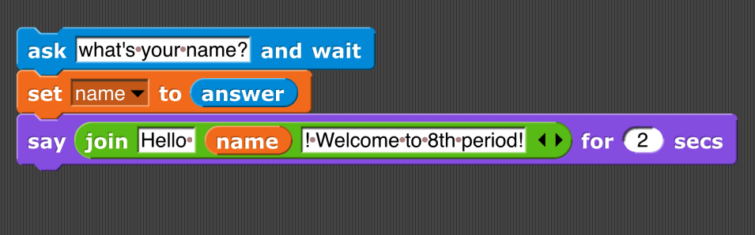
Discussion - What does the code do?

Slide 43
Code comment
What happens when I run the statement above?
A: Absolutely nothing!
Why?
A: Because “#” makes it a comment

Slide 44
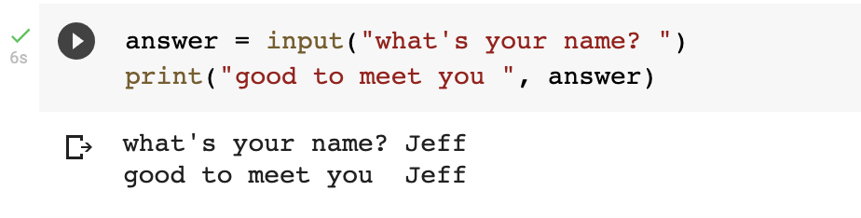
Input statement
What’s the input statement for?
A: Lets you input data and save it to a variable

Slide 45
Input statement - string
BTW, what’s the data type of value saved to answer?
A: It’s a string. The input statement always returns a string.

Slide 46

Input statement - error
What will happen when I run this code?
A: It will give me an error!

Slide 47

Input statement – int()

Slide 48
Lab – magic genie
Project objective
Use Python to interact with variables and user input
Create a genie program. Save the file as magic_genie.ipynb.

Slide 49
Project specifications
Have the program introduce itself
Have the program ask for three separate wishes
Print all the wishes together
There are some repeated strings in this genie program
  Move those into variables
Image of Output. Here is the test
I am a genie. You have three wishes
What would you like to wish for? cats
What would you like to wish for? kittens
What would you like to wish for? more cats
Your wishes are cats, kittens and more cats

Slide 50
Genie Confusion
Now it’s time to make your genie confused
Edit your code to have him
  Print your first wish as your last wish
  Your second wish as your first wish
  Your third wish as your second wish
I am a genie. You have three wishes
What would you like to wish for? cats
What would you like to wish for? kittens
What would you like to wish for? More cats
Your wishes are kittens, more cats and cats

Slide 51
Hint
Remember to add spaces. You can combine " " to the end of your string using the + operator
So print("hello" + " " + "student") would print hello student

Slide 52
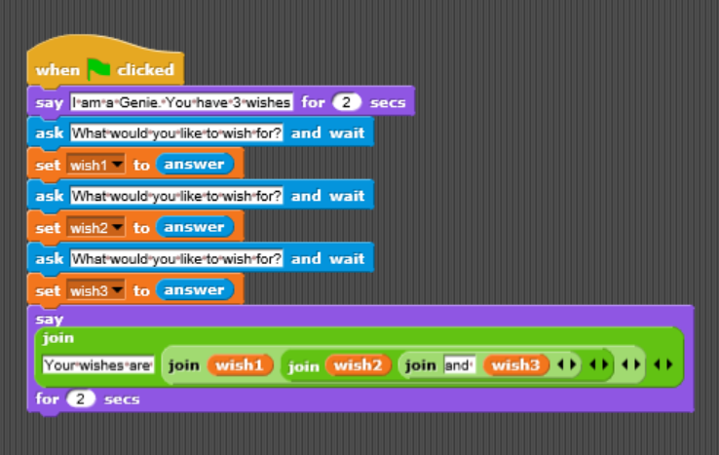
Snap! Flashback
Look at how you would write this code in Snap!

Slide 53
Lesson 1.05: Quiz & Debugging
Microsoft Philanthropies TEALS Program – Introduction to Computer Science – Semester 2

Slide 54
Quiz & Debugging
After this lesson, you will be able to...
Demonstrate their understanding of key concepts covered up to this point
Define and identify debugging, syntax errors
Analyze and respond to error messages

Slide 55
Plan
Welcome and Review
Quiz
Debugging Activity
Notes:
5 Minutes Welcome and Review
25 Minutes Quiz
25 Minutes Debugging Activity

Slide 56
Welcome and Review
Are there any questions prior to taking today’s quiz?
Notes:
4 Steps to Solve Any CS Problem
Remind students of the 4 Steps to Solve Any CS Problem
Project Overview
Demo the Oregon Trail finished project.
Give out the project spec and go over game rules.
Planning
Have students draw out the game play.
Students should plan to create functions for each user interaction by figuring out where the repeated code will be.
Students should list out which variables they will need.
Have students plan out their next 7 days. Suggested timeline/checkpoints below:
Set up user inputs with dummy functions, make sure game loop works
Create variables necessary to run the game, start implementing basic functions
Focus on the random functions
Figure out how to move the days
Finish day updating
Connect functions together
Wrap up and game over check is correct
Accommodation/Differentiation
Advanced students can add in random events like cholera or snake bites. Students can also have a list of travelers instead of just 1, where each traveler is affected differently by each action.
The planning phase of this project will be essential, especially for students who you think may struggle with this project. Provide more guidance and scaffolding to those students that need it.

Slide 57
Quiz

Slide 58
Debugging Activity
Exploring and Analyzing Code for errors
In your notebook, predict what will happen when you run this code
favorite_number_str = input("What is your favorite number: ")
birth_month_str = input("What month where you born in: ")
lucky_number = int(favorite_number_str) + int(birth_month_str)
print("Your lucky number is " + lucky_number)
Remind students that when reading through code we go line by line, as if we are the interpreter.
Notes:
favorite_number_str = input("What is your favorite number: ")
birth_month_str = input("What month where you born in: ")
lucky_number = int(favorite_number_str) + int(birth_month_str)
print("Your lucky number is " + lucky_number)

Slide 59
Demonstration
Demonstrate code from previous slide
Debugging is the process of tracking and fixing errors in your code.
Common Errors – Indentation Errors
Work through and complete this web tutorial on debugging: https://runestone.academy/ns/books/published//thinkcspy/Debugging/KnowyourerrorMessages.html

